Slide 1
CS 31006: Computer Networks – QoS at the Internet

Slide 2
Revisiting Congestion
Does TCP Congestion Control ensure NO CONGESTION in the network?
How does congestion impact network performance?
Bandwidth
Delay
Jitter
Loss

Slide 3
Network Bandwidth
Amount of data that can be transmitted over a link within a fixed amount of time.
“When a drain chronically runs slow even though it isn’t plugged, it’s time to get a bigger pipe.“ – QoS vs more bandwidth, by Tim Greene
Some applications in the network are bandwidth hungry – video applications; congestion limits per user bandwidth.
Improve bandwidth – design networks with high capacity

Slide 4
Delay
Three components – (a) transmission delay, (b) propagation delay, (c) queueing delay
Transmission Delay: Amount of time to push all the packet bits in the network. Bandwidth 10 Mbps, Packet size 1 KB, Transmission delay?
Propagation Delay: Time to transfer one bit from one end of the link to another end of the link; usually depends on the underlying communication media
Queuing Delay: Delay at the interface buffer; the major delay component

Slide 5
Delay
In general,
Queuing delay >> Transmission delay + Propagation delay
Packet multiplexing in the network devices (like routers, switches) impact the queuing delay
Impact of congestion – increase in queuing delay

Slide 6
Jitter
Variation in End to End delay
Why jitter impacts application performance – video streaming; consider delay variation among different video frames

Slide 7
Loss
A relative measure of the number of packets (or segments or bits) that were not received compared to the total number of packets (or segments or bits) transmitted.
Loss is a function of availability
If the network is available (capacity more than the demand) then loss would be generally zero (Note: This assumption is not true for wireless networks)
Congestion increases data loss from the intermediate network devices

Slide 8
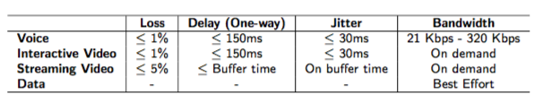
Application QoS
Different application requires different level of QoS – delay, jitter and bandwidth
Source: http://www.ciscopress.com/articles/article.asp?p=357102

Slide 9
A Formal Definition of QoS
“Quality of Service (QoS) refers to the capability of a network to provide better service to selected network traffic over various technologies, including Frame Relay, Asynchronous Transfer Mode (ATM), Ethernet and 802.1 networks, SONET, and IP-routed networks that may use any or all of these underlying technologies. The primary goal of QoS is to provide priority including dedicated bandwidth, controlled jitter and latency (required by some real-time and interactive traffic), and improved loss characteristics. “
Source: Cisco - http://docwiki.cisco.com/wiki/Quality_of_Service_Networking

Slide 10
Ensure QoS over a Packet Switching Network
What applications need from the network
How to regulate the traffic that enters the network
How to reserve resources at router to guarantee performance
Whether the network can safely accept more traffic
Section 4, Chapter – THE NETWORK LAYER, Computer Network by Tanenbaum

Slide 11
Primary QoS Parameters
Bandwidth
Delay
Loss
Jitter

Slide 12
Flow
A stream of packets from a source to a destination is called a flow.
Source to Destination:
Machine to Machine
Process to Process
Application to Application
Socket to Socket
Different flows require different levels of QoS

Slide 13
Why QoS is Considered at the Network Layer
Maintaining QoS requires both per-hop and end-to-end behavior
End-to-end performance needs to be monitored
End-to-end delay
End-to-end bandwidth
End-to-end jitter
Total end-to-end data loss
However, resource reservation needs to be on per-hop basis – otherwise end-to-end requirements can not be guaranteed
Network layer bridges end-to-end (Transport) and Per-hop (Data Link Layer)

Slide 14
Application Classes based on QoS
Constant bit rate (e.g. telephone applications – VoIP)
Real time variable bit rate (e.g. videoconferencing)
Non real-time variable bit rate (e.g. on demand video streaming – IPTV)
Available bit rate or Best effort (e.g. File transfer)

Slide 15
Basic QoS Architecture
Source: https://www.cisco.com/c/en/us/td/docs/solutions/Enterprise/WAN_and_MAN/QoS_SRND/QoS-SRND-Book/QoSIntro.html

Slide 16
Basic QoS Architecture
Admission Control: Ensures that new flows are entered in the network only if the QoS of all the existing flows along with the new flows can be satisfied

Slide 17
Admission Control
Remember the phase from cellular networks – “all lines are busy; please dial after sometimes”
The network does not allow new flows if all the network resources are blocked in servicing the existing flows based on their QoS requirements

Slide 18
Basic QoS Architecture
Classification and Marking: Classifies the packets based on their application QoS requirements, and mark the packets accordingly

Slide 19
IP Type of Service (ToS) Field

Slide 20
Basic QoS Architecture
Policing and Markdown: Monitor the flow characteristics and take appropriate actions based on the flow QoS

Slide 21
Traffic Policing
Service Level Agreements (SLA): An agreement or a contract between the customer and the service provider to maintain QoS of an application
Traffic policing monitors the flow of traffic and mark them to take appropriate actions (reduce priority, drop etc.)

Slide 22
Basic QoS Architecture
Scheduling: Based on markdown by the traffic policers, schedule the traffic into output buffers of an interface

Slide 23
Traffic Scheduling based on Queuing
Maintain multiple Queues at the interface, the scheduling mechanism services the queues based on the scheduling policy
Example: Priority Queuing
Image source: http://www2.ic.uff.br/~michael/kr1999/6-multimedia/

Slide 24
Basic QoS Architecture
Traffic Shaping: Control the outgoing traffic rate irrespective of the incoming traffic rate (e.g. constant bit rate output from the interface buffer)

Slide 25
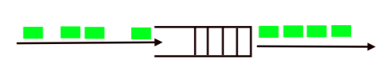
Traffic Shaping
Input traffic is bursty
Output traffic has constant packet rate – reduces the jitter

Slide 26
Traffic Policing versus Traffic Shaping
Source: https://www.cisco.com/c/en/us/support/docs/quality-of-service-qos/qos-policing/19645-policevsshape.html

Slide 27
Leaky Bucket for Traffic Policing
Incoming packets are put in the packet queue – the packet queue works as a bucket
A single server queue with constant service time
If the bucket overflows that the packets are discarded
Input rate can vary but the output remains constant

Slide 28
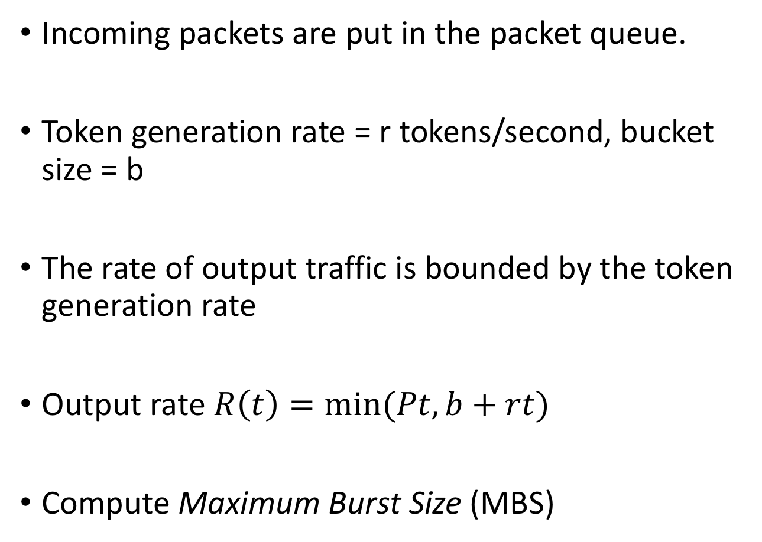
Token Bucket for Traffic Policing
Incoming packets are put in the packet queue.
Token generation rate = r tokens/second, bucket size = b
The rate of output traffic is bounded by the token generation rate
Output rate $R\left(t\right)=min⁡(Pt,b+rt)$
Compute Maximum Burst Size (MBS)

Slide 29
Leaky Bucket versus Token Bucket
Leaky Bucket: Smooth out traffic but does not permit burstiness
Token Bucket: Smooth out traffic and also permits burstiness – if there is no incoming packet, tokens are get added in the token bucket, and the burst traffic is permitted up to the amount of token accumulated
Both the leaky bucket and the the token bucket algorithms can be used for traffic shaping, with the addition of a playout buffer
A buffer to add some additional delay to the packets that arrived too early.

Slide 30
Scheduling – Priority Queuing
High
Outgoing Traffic
Incoming Traffic
Classifier
Scheduler
Medium
Low
Transfer traffic from lower priority queues once the higher priority queues are empty

Slide 31
Scheduling – Custom Queueing
0.3
Outgoing Traffic
Incoming Traffic
Classifier
Scheduler
0.2
0.5
Different queues are of different size – works like transmission window
Supports guaranteed bandwidth

Slide 32
Scheduling – Weighted Fair Queuing (WFQ)
Outgoing Traffic
Incoming Traffic
Classifier
Scheduler
Ensure fairness among the flows – every flow will get equal amount of bandwidth
Queues can be assigned with a weight – fairness proportional to the weight

Slide 33
Congestion Avoidance in the Internet
Avoid congestion by controlling the queue parameters
Different from TCP congestion control
TCP response on detection of the congestion
Congestion avoidance – ensure that a flow performance does not get affected by the congestion
If congestion avoidance is there at the network layer, do we still need congestion control at transport layer?

Slide 34
Why Congestion Avoidance is Necessary for QoS
Internet carries multiple data packets from different applications having different QoS requirements
Elastic traffic – TCP like traffic, elastic nature of flow control based on AIMD
Inelastic Traffic – UDP traffic, smoothed or controlled or constant bit rate traffic
Inelastic traffic is preferred for real time applications – Can you say why? (NB: Don’t confuse with YouTube, YouTube like applications work over HTTP to support a broad range of network supports, like network behind proxy; think of VoIP or IPTV)

Slide 35
Why Congestion Avoidance is Necessary for QoS
Which traffic will dominate over the link?
A
C
Elastic Traffic
B
Inelastic Traffic
D

Slide 36
Random Early Detection (RED)
Drop probability if different for different traffics, depending on the nature – elastic or inelastic
RED smooths out the drop probability across all the flows depending on the congestion probability
Detect the possibility of congestion in the Internet. If congestion possibility is high, RANDOMLY drop packets before the enqueue

Slide 37
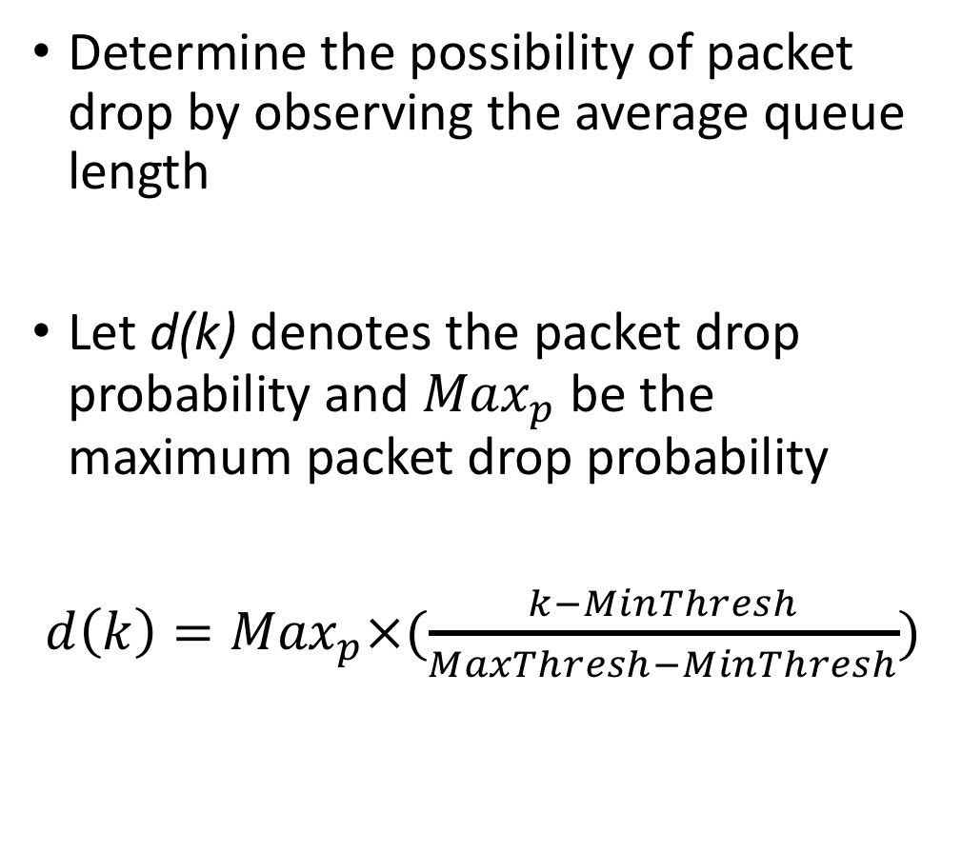
Random Early Detection (RED)
Determine the possibility of packet drop by observing the average queue length
Let d(k) denotes the packet drop probability and ${Max}_{p}$ be the maximum packet drop probability
$d\left(k\right)={Max}_{p}×(\frac{k−MinThresh}{MaxThresh−MinThresh})$
Source: https://en.wikipedia.org

Slide 38
Random Early Detection (RED)
Source: http://www.eng.uwi.tt/

Slide 39
QoS in TCP/IP Internet
Differentiated Service (DiffServ) Architecture
Expected service – every intermediate routers try their best to support QoS for the flows
Works over a distributed architecture
Metering and Traffic shaping – every router estimates the QoS and according applies traffic shaping and queue scheduling
Integrated Service (IntServ) Architecture
Guaranteed service
Strong coordination is required among the routers to pre-reserve resources based on the SLA
Resource reservation protocol (RSVP)

